Slide 1






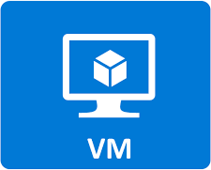


Data Ingestion : Spring Cloud Framework
This framework helps various teams to publish their data into the data lake. It will enable to crowd source the data pipelines construction and minimize the time and effort involved in data ingestion for streaming and batch processing.
Spring server
Runtime Platform
Middleware Layer
Hadoop Cluster
Presentation Layer
Customer Challenges :
Non standard data pipeline activities – tool based and open source. Inconsistencies with the data model and implementation.
Dependency on the tools specific knowledge resources.
Lack of scalability across different areas since every one has their own plans and strategy.
Resource constraint with the data teams related to data handling and governance
Syntel Solution:
Develop the solution, develop a pilot as a “proof of concept "project and train all the other team members to implement the data ingestion framework to create the data pipeline as a part of the self sufficient strategy.
Resources:
3 team members for a duration of 4 months.
Production :
Yes, Already moved in production for multiple data pipelines

Slide 2
What Spring Cloud DataFlow be used for?
ETL processing between file systems and databases – Being a platform for orchestration, building Extract, Transform, Load (ETL) processes is one of the core strength of Spring Cloud Data Flow. GUI designer makes designing the workflows easy.
Building real time data analytics – Because it is so easy to create and configure the pipelines, Data Flow can be used for building real time analytics. There are multiple good example uses of twitter analytics.
Integrating data oriented microservices – Moving data between microservices is made easier with the platform. Microservices are supposed to own their own data, but that does not mean, that the data does not have to be moved. This can be seen as a sub-case of the ETL use case.
Event streaming – If you want to use messaging in your system, but you want to have only explicit flows (as opposed to the choreographed approach), Spring Cloud Data Flow is the tool that you were looking for.
Notes:
https://www.e4developer.com/2018/02/28/spring-cloud-data-flow-use-cases/

Slide 3
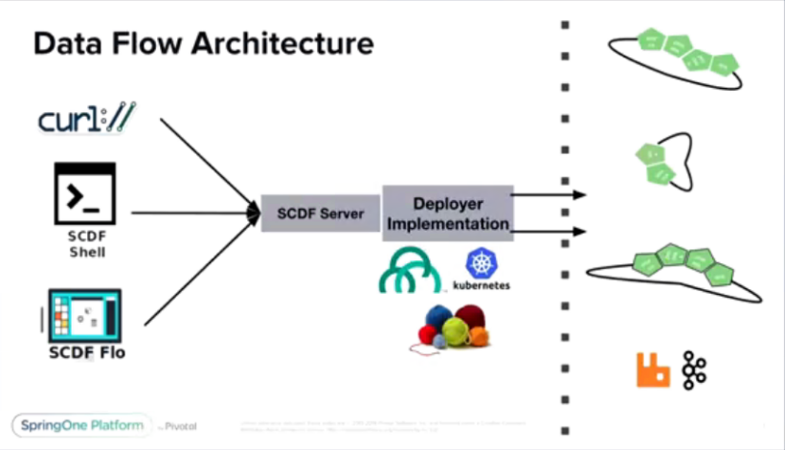
Building Cloud Native Data Pipelines
Develop
SCDF Shell – based on spring shell
SCDF FLO – UI based designer
Deploy
Cloud Foundry –
Kubernetes –
Yarn -

